Slide 1
Coptic Lesson 4
Coptic Letters that are Easy to Remember

Slide 2
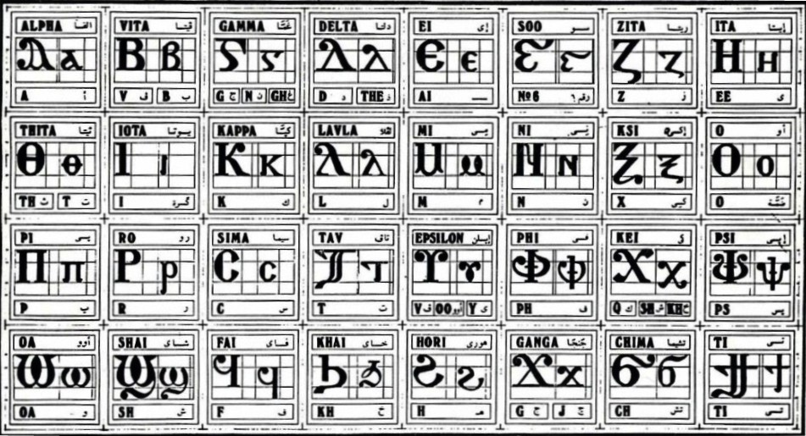
Coptic Alphabets

Slide 3
Letters that are Easy to Remember
L l = L (Lavla)
: ; = th, t (Thita)
P p = p (Pi)
V v = ph (f) (Phi)
" ' = ps (Psi)
{ [ = ch (Chima)

Slide 4
Review
L : P V ' [
S q J G
D Y R <
A B E Z I K M N O C T W

Slide 5
Questions
G
g, gh, n
Ghamma
l
L
Lavla
v
ph
Phi
P
p
Pi
,
k, sh, kh
Kei
'
ps
Psi
:
Th, t
Thita

Slide 6
Coptic Reading – Part 1
va ve vy vi vo vw
pa pe py pi po pw
ja je jy ji jo jw
la le ly li lo lw
;a ;e ;y ;i ;o ;w
[a [e [y [i [o [w
'a 'e 'y 'i 'o 'w

Slide 7
Coptic Reading – Part 2
a[ e[ y[ i[ o[ w[
al el yl il ol wl
av ev yv iv ov wv
a; e; y; i; o; w;
ap ep yp ip op wp
a' e' y' i' o' w'
ag eg yg ig og wg

Slide 8

Coptic Alphabet Song

Slide 9
Coptic Alphabets

Slide 10
Announcement
Coptic Servant is working next Saturday.

Slide 11

Oujai qen `P[oic

